Slide 1
Building Social Community for MOOCs Content Users (Based on a project from the 2015 Google MOOC Focused Research Award)
Timothy K. Shih, NCU, Taiwan

Slide 2
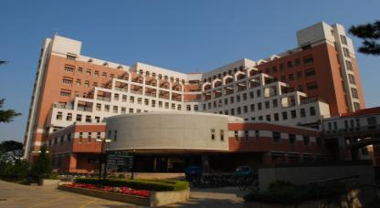

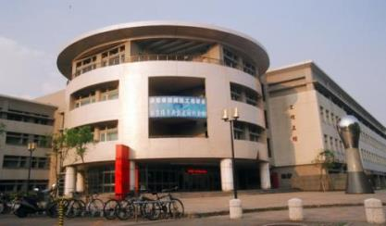
About My University
Top-5 University in Taiwan

Slide 3
Outline
Different Platforms and communities for MOOCs
How do we exchange contents in MOOC communities
Reusability and revisions of Learning Objects
Searching, sharing, and reusing Learning Objects
Building social communities for MOOCs
Extending MOOC communities using social network tools
Recommending potential experts and hot topics
Conclusions

Slide 4



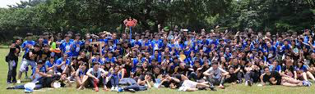

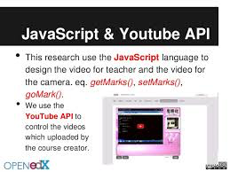


The Big Picture
Educaton
Platform and Community for MOOCs Content Users
http://www.wasp.dk
http://www.learndash.com
http://blog.accredible.com
David Chiu @ 2014 Data Science with R Workshop

Slide 5
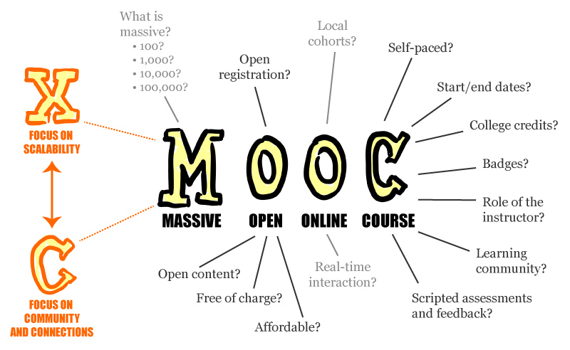
What are MOOCs
MOOCs: Massive Open Online Courses
MOOCs may create a massive Social Community
What can we do from MOOCs and Social Community?
Analysis of student → course recommendation
Analysis of instructor → content recommendation and sharing
Analysis of MOOCs program → strategic planning
https://en.wikipedia.org/wiki/Massive_open_online_course

Slide 6
Differences between e-Learning and MOOCs
Background: network bandwidth and video technology
Style: Flipped Classroom
Big names: big number of students
Need Powerful Platforms and Contents
Auto grading, peer grading, auto grouping, virtual labs
Analysis of learning behavior and infrastructure usages
High quality learning contents: lectures, labs, tutorials, exams

Slide 7

About Platforms
LMSs (Learning Management Systems) for e-Learning
Moodle, SCORM-based LMS, Web CT, Blackboard
MOOCs
Coursera, Open edX, Khan Academy, Course Builder (Google)
MOOCs using Open edX
MIT, USA
Stanford University, USA
XuetangX, China
Institut Aristotélicien d'Études Scientifiques, France
Universidad Carlos III de Madrid, Spain
Anadolu University, Turkey
National Platform of Open Education, Russia
NCU Open edX Lab (for Open edX in Taiwan)

Slide 8
About Content Formats
Most contents for MOOCs are proprietary
Different platforms are designed in different view
Content and metadata representations
Discussion board – part of lecture or learning activity?
Assessment – included or separated from learning materials?
Virtual Lab exercises, homework, experience sharing
Others
Is there a standard for content representation of MOOCs?
There is one for e-Learning – SCORM 2004
Issue: Do we need such a MOOCs standard?
To encourage content exchange
To build a social community

Slide 9







About MOOCs Social Communities
Education is powerful
Social media is also powerful
How about Social Media for Education?
Content is the Key
Students and instructors are the channels
Goal: to promote MOOC contents
http://c4lpt.co.uk

Slide 10

About Google Project
Research at Google
The Google MOOC Focused Research Awards, Monday, March 09, 2015
http://googleresearch.blogspot.tw/2015/03/announcing-google-mooc-focused-research.html
“Reusability Measurement and Social Community Analysis from MOOC Content Users” - Timothy K. Shih, National Central University, Taiwan

Slide 11
Three Goals
The specification of Exchangeable Learning Object (ELO)
One week of lecture materials
An ELO authoring/search tool and a common repository test-bed
An on-line social community tool for ELO
Project Website: http://edxpdrlab.ncu.cc

Slide 12
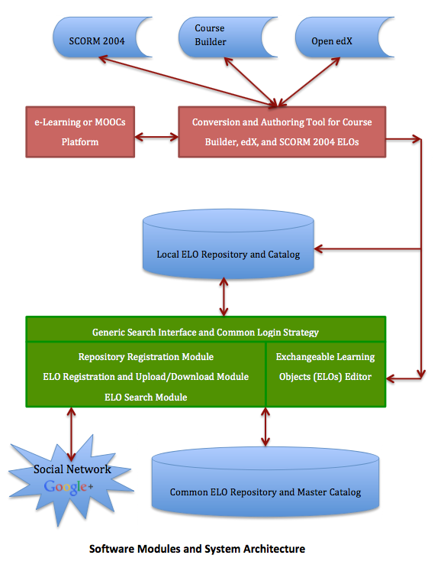

The Project Scope
Content exchange among three platforms
ELO Repository
ELO Editor and Searching Tool
Two social networks
Author Network
Google+ for additional users

Slide 13
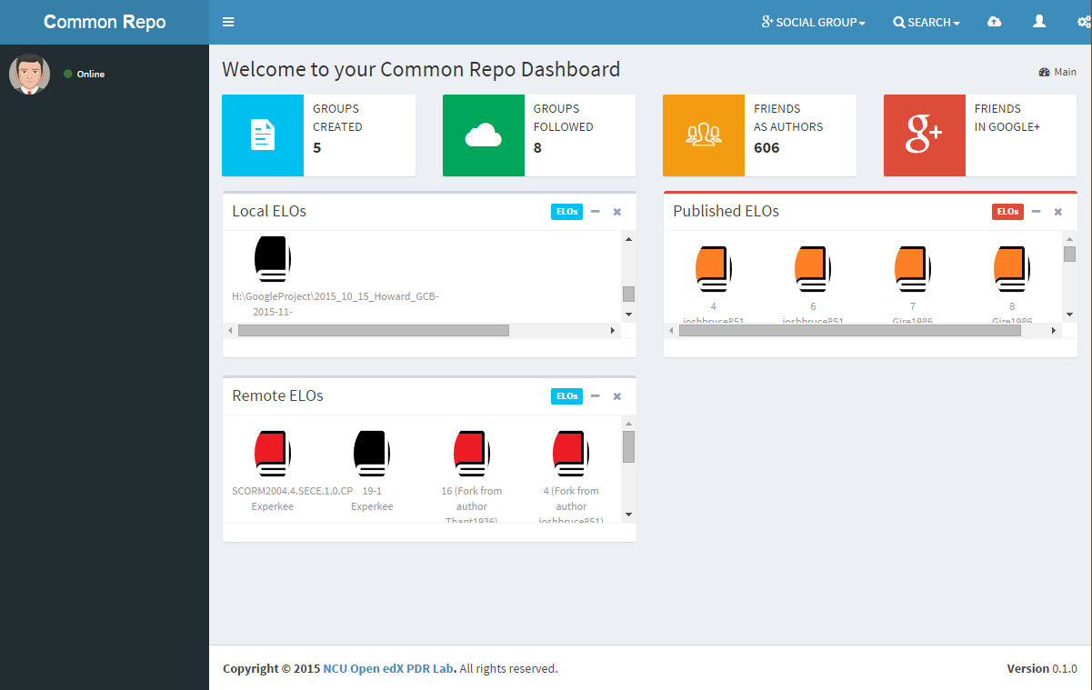
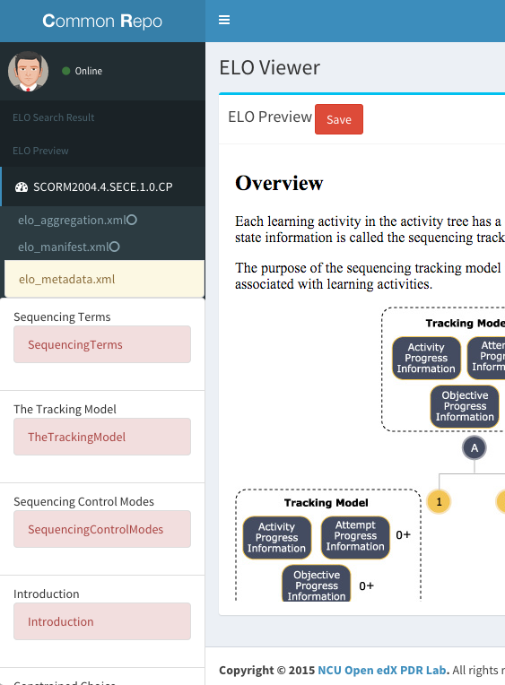
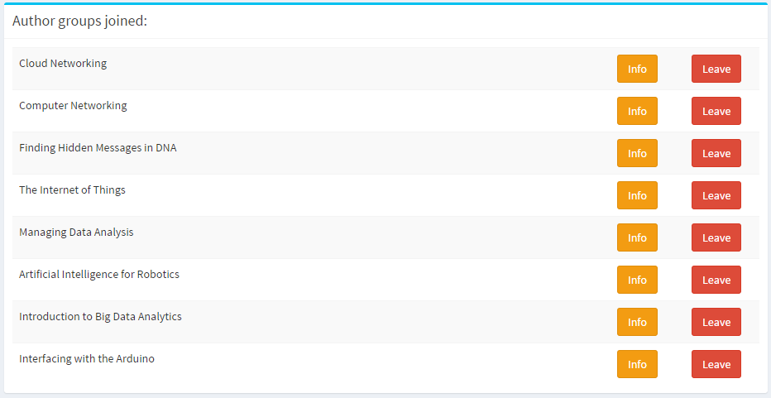
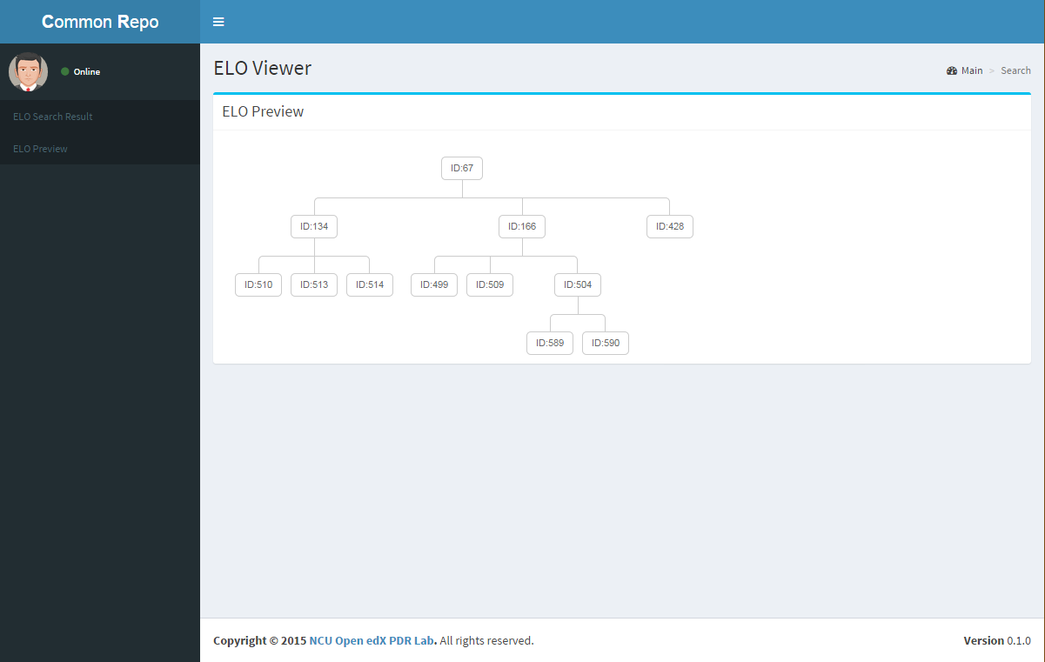
Tools Developed

Slide 14
About Learning Objects
High Quality Instruction
Guided Search
LMSs
Authoring Tools
Materials
Sequence Content Presentation
Create & Associate Meta-data
Student Enrollment
Course Enrollment
Designate Instructors & Assign Instructor Rights & Roles
Match Students with Instructors
Monitor/Track Student/Learner Performance
Create Content
Package Content
Export Content
Import Content
Metadata
Reusability
Store Content
Repackage Content
Gather Content (push/pull using meta-data & federated searches)
Publish Content (provide meta-data to other repositories)
Learning Objects
Searchability
Repositories
Source: ADL
Revised for Presentation

Slide 15
About the SCORM Specification
SCORM (Sharable Content Object Reference Model)
Developed by Advanced Distributed Learning (ADL, https://www.adlnet.gov/about-adl/)
SCORM 2004
Main Components:
Content Aggregation Model
LEEE LOM (Learning Object Metadata)
SCORM RTE
Sequencing and Navigation Model

Slide 16
The Development Groups
IMS Global Learning Consortium, Inc.
Aviation Industry CBT (Computer-Based Training) Committee (AICC)
Alliance of Remote Instructional Authoring & Distribution Networks for Europe (ARIADNE)
Institute of Electrical and Electronics Engineers (IEEE) Learning Technology Standards Committee (LTSC)

Slide 17
The Missing SCORM Pieces
October 1, 2001
January 31, 2000
SCORM 1.2
(Add Packaging)
July 22, 2004
SCORM 2004
SCORM 1.0
October 22, 2003
SCORM 1.3 Working Draft 1
November 27, 2002
SCORM 1.3
Seq. Application Profile
WORKING DRAFT 0.9
Revised
Content Aggregation Model
Revised Sequencing & Navigation
Sequencing & Navigation
Improved
Data Model
Element

Slide 18
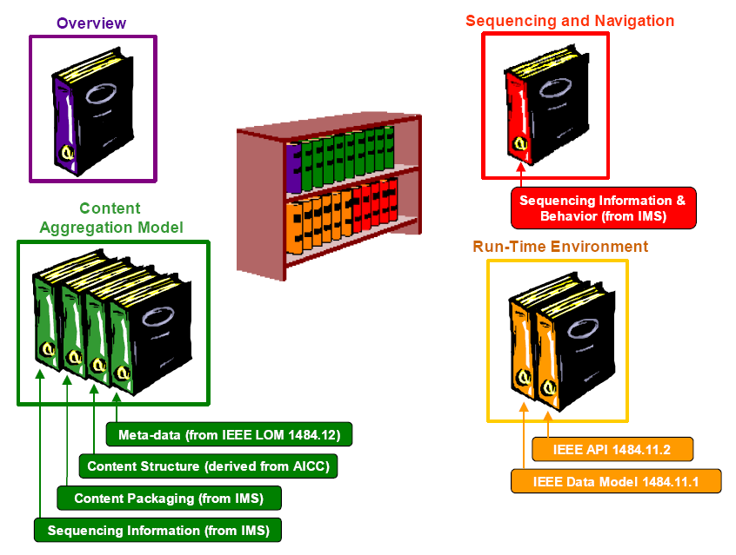
SCORM Overview
The Department of Defense of USA established the Advanced Distributed Learning (ADL) initiative in 1997.
The Sharable Content Object Reference Model (SCORM) includes
Content Aggregation Model
Run-time Environment
Simple Sequencing Specification (in 1.3 WD)

Slide 19
Conceptual Point for SCORM
Accessibility: the ability to locate and access instructional components from one remote location and deliver them to many other locations.
Adaptability: the ability to tailor instruction to individual and organizational needs.
Affordability: the ability to increase efficiency and productivity by reducing the time and costs involved in delivering instruction.

Slide 20
Conceptual Point for SCORM
Durability: the ability to withstand technology evolution and changes without costly redesign, reconfiguration or recoding.
Interoperability: the ability to take instructional components developed in one location with one set of tools or platform and use them in another location with a different set of tools or platform.
Reusability: the flexibility to incorporate instructional components in multiple applications and contexts.

Slide 21
Overview of the SCORM Content Aggregation Model
The purpose of the SCORM Content Aggregation Model is to provide a common means for composing learning content from discoverable, reusable, sharable and interoperable sources.
The SCORM Content Aggregation Model further defines how learning content can be identified and described, aggregated into a course or portion of a course and moved between systems that may include Learning Management Systems (LMS) and repositories.
Content Packaging
Meta-data
Sequencing and Presentation

Slide 22
Overview of the SCORM Run-Time Environment
The purpose of the SCORM Run-time Environment is to provide a means for interoperability between Sharable Content Object-based learning content and Learning Management Systems. A requirement of the SCORM is that learning content be interoperable across multiple LMSs regardless of the tools used to create the content. For this to be possible, there must be a common way to start content, a common way for content to communicate with an LMS and predefined data elements that are exchanged between an LMS and content during its execution.
Application Programming Interface (API)
Data Model

Slide 23
Overview of the SCORM Sequencing and Navigation
Sequencing and Navigation describes how SCORM-conformant content may be sequenced to the learner through a set of learner-initiated or system-initiated navigation events. The branching and flow of that content may be described by a predefined set of activities, typically defined at design time.
The Sequencing Definition Model
Sequencing Behaviors
The SCORM Navigation Model

Slide 24
Functionality by Projects
Authoring Tools
LMSs
Sequence Content Presentation
Create & Associate Meta-data
Student Enrollment
Course Enrollment
Designate Instructors & Assign Instructor Rights & Roles
Match Students with Instructors
Monitor/Track Student/Learner Performance
Create Content
Package Content
Export Content
Import Content
Store Content
Repackage Content
Gather Content (push/pull using meta-data & federated searches)
Publish Content (provide meta-data to other repositories)
Repositories

Slide 25
Reusability and Revisions of LOs
IEEE LOM defines metadata for learning objects
A Repository stores these learning objects
What happen next?
Reusability
Search for and make copy of an ELO
Modify part of the learning object
Are the new and the original objects related?
Search
Should the association among ELOs be retrieved?
Revision Control

Slide 26
The Reusability Tree
A new ELO created may inherit properties from its original
Inheritances
Contents
Metadata
Structure
Rules
Evolution of changes must be maintained
ELO O
ELO A
(change structure)
ELO B
(change rule)
ELO C
(change content)
ELO D
ELO E
ELO F
ELO G
(structure from D
contents from F)

Slide 27
Metadata as Search Criteria
Mandatory searching criteria
Minimal set, to ensure recall ratio, e.g., Keyword
Incremental searching criteria
Sufficient set, dynamically added, to ensure precision ratio, e.g., Title, Min/Max Version
Issues in ELO Searching
Search Criteria and Match Function
Similarity and Diversity of ELOs
Relevancy of ELOs in an aggregation

Slide 28
Reusability Tree
A Query
LO₁(CPU Concept)
LO_{q}
LO₁
CPU History
CPU Category
LO_{q}
CPU Market
CPU History
LO₂
LO₃
LO₄
CPU Category
CPU Structure
LO₂(CPU Concept)
LO₃(CPU Concept)
LO₄(CPU Concept)
CPU History
CPU History
CPU Design
LO_{q} = LO₁
LO_{q} = LO₂
LO_{q} = LO₃
LO_{q} = LO₄
_{Best Matching?}
CPU Market
RISC
CPU Category
CPU Structure
CPU Design
CISC
Hardware Control
Microprogrammed Control
Notes:
As an illustration of the reusability tree, this figure shows the history of evolution of a learning object LO1. The LO is retrieved and used by three different authors, with changed LOs) inserted into the repository, like, LO2, LO3, and LO4. The reusability tree keeps track of the association among these objects. When a new user issues a query, this query is compared with all LOs in the repository. Now, we take LOq as query example.
Since LOq has three descendants (i.e., CPU History, CPU Category, and CPU Structure), it is likely that LOq matches only with LO1 and LO2 under some threshold. In a practical implementation, since the similarity between LOq and LO3 is below a threshold, LO3 is disregarded. Similarly, LO4 is not recommended. Therefore, the new user only finds LO1 and LO2. However, usually, when a user searches for a LO, additional information related to the query plays an important role. That is, information such as “CPU Market” and “Microprogrammed Control” could be unexpected but meaningful to the course designer when he design a CPU course. With the proposed reusability tree, we introduce a set of measurement methods, along with their implementation methods, to help the user discover such additional information.

Slide 29
Search Criteria – Analysis of LOM
Precise Criteria: 6 items, items that must be precisely described
(e.g., Title = “Photoshop Tutorial”, Language = “en”).
Incremental Criteria: 10 items, items that can be revised to constrain a search specification
(e.g., Keyword = “Tamkang University”, Keyword = “Tamkang University AND MINE Lab”, Keyword = “Tamkang University AND MINE Lab AND Freya Lin”).
Precedence Criteria: 5 items, the items can be evaluated with a operator such as <, <=, >, >=, = and !=
(e.g., Size >= 1024, Interactivity Level > medium, Semantic Density <= low).

Slide 30
Search Criteria – Analysis of LOM
Time/Duration Criteria: 5 items, time items that can be searched with a operator such as <, <=, >, >=, = and !=
(e.g., Date > 2006-03-20, Duration <= PT1H30M).
Single Choice Criteria: 21 items, only one vocabulary can be chosen for the item
(e.g., Aggregation Level = sco, Minimum Version = 5.0).
Many Choice Criteria (disjunction): 7 items, multiple vocabularies can be chosen for the item
(e.g., Intended End User Role = teacher OR author, Purpose = idea OR discipline).

Slide 31
Match Function
The match function is used in the evaluation of similarities between two ELOs
match(O_{a}, O_{b}) =Σ(∀M_{i} ∈ O_{a} ∃! M_{j} ∈ O_{b} • e(M_{i}, M_{j})) / m
V₁ = 1.0, if M_{i} and M_{j} are the same Precise or Single Choice Criteria;
= 0.0, otherwise
where e(M_{i}, M_{j}) =
V₂ = f(M_{i}, M_{j}), if M_{i} and M_{j} are Incremental Criteria
V₃ = c(M_{i}, M_{j}), if M_{i} and M_{j} are Precedence or Time /Duration Criteria
V₄ = d(M_{i}, M_{j}), if M_{i} and M_{j} are Many Choice Criteria
Different functions are defined for different metadata
Notes:
match function is used in the evaluation of similarities of LOs and finding exactly matching metadata items.
The function f(Mi, Mj) takes two incremental criteria and performs a fuzzy match using an ordinary keyword search mechanism, and returns a real number between 0.0 and 1.0 to indicate the strength of match. Similarly, the function c(Mi, Mj) evaluates the precedence order or compares the order of time point/duration slot. If the condition is satisfied returns 1.0; otherwise, return 0.0.
The function d(Mi, Mj) reviews the alternatives provided in a disjunctive expression (logical OR expression), and returns 1.0 if the condition is satisfied; 0.0 otherwise.
In a practical system, the user may optionally select a weight for the values V1, V2, V3, and V4, to emphasize a particular type of search preference. The accumulated values from each type of comparison are divided by the number of effective metadata entries, m.
Missing metadata items are not counted in the match function.

Slide 32
Similarity Function
Define how LO_{t} matches LO_{q}
Is non-symmetric
Taken from the perspective of the query Lo_{q}
Similarity(LO_{q}, LO_{t}) =
Σ(∀DO_{i} ∈ LO_{q} ∃! DO_{j} ∈ LO_{t} • match(DO_{i}, DO_{j}) ≥ α) / |LO_{q}|
Freya H. Lin, Timothy K. Shih (corresponding), and Won Kim, “An Implementation of the CORDRA Architecture Enhanced for Systematic Reuse of Learning Objects,” IEEE Transactions on Knowledge and Data Engineering, 21(6), 2009.
Notes:
The similarity function is taken from the perspective of the query. A LO can contains a number of descendant objects, such as SCOs or assets, we note as Dos in the equation.
Similarity Function defines how much a query LO and target LOs they match. Therefore, decomposition of a query LO and target LOs is necessary.
We use following example to illustrate this function.

Slide 33
An Example
LO_{q}
LO₁
LO₂
LO₃
LO₄
A
A₂
A₂
C₂
E₂
B
B₂
C₂
E₂
F₂
C
C₂
D₂
Similarity Values
Threshold α = 0.5
Similarity(LO_{q}, LO₁)
=((match(A, A₂)+match(B, B₂)+match(C, C₂))/3
=(1.0+0.9+0.8)/3=0.9
Similarity(LO_{q}, LO₂)
=((match(A, A₂) +match(C, C₂))/3
=(1.0+0.8)/3=0.6
Similarity(LO_{q}, LO₃)
=match(C, C₂)/3
=(0.8)/3=0.3
Similarity(LO_{q}, LO₄)=(0)/3=0
Notes:
As an example, two sets of metadata items are given.
The first set is the metadata of a “query learning object” . That means a LO being searched. And the second set is for a target LO.
The Single Choice Criteria <aggregationLevel> is used. Since both LOs use LOMv1.0, the match function returns V1 = 1.0. There are three Incremental Criteria used in the two examples, which include <title>, <keyword> and <size>. The title “CPU History” and “CPU Concept” does not match each other. However, the first keyword, “CPU”, in the query matches a keyword in the target. The <size> metadata does not match. Therefore, V2 is evaluated to 1.0 once and 0.0 twice. The Time/Duration Criteria has a <duration> metadata. If the user indicates a need of finding a resource with a duration larger than “>PT1H10M”, the criterion “>PT1H30M” of the target LO satisfies. Thus, V3 = 1.0. Consequently, with the 5 items, there are three matched items. Thus the match function returns a value of 0.6.

Slide 34
Diversity Function
Find out how much additional information that can be used in the target LO
Irrelevant to the search criteria but meaningful
Computed at the same time when the function “Similarity” is evaluated
As a dual complement of similarity
Non-symmetric
Diversity(LO_{q}, LO_{t}) =
Σ(∀DO_{i} ∈ LO_{q} • ¬(∃ DO_{j} ∈ LO_{t} • match(DO_{i}, DO_{j}) ≥ α) ) / |LO_{q}|
Notes:
The diversity of a search process w.r.t. a query LO may represent the degree of additional useful descendant objects irrelevant to the search criteria but meaningful.
In other words, diversity represents the hidden information in the search targets, w.r.t. a given search criteria. Therefore, considering diversity as a dual complement of similarity, we define the function as this equation.
As well, we use following example to illustrate this equation.

Slide 35
Revised Diversity Function
The concept of dual complement could be misleading
Redefine the Diversity Function as a symmetric function
Diversity(LO_{q}, LO_{t}) = ½(log•1/Similarity(LO_{q}, LO_{t})+log•1/Similarity(LO_{t}, LO_{q}))
=½ (-log Similarity(LO_{q}, LO_{t}) -log Similarity(LO_{t}, LO_{q}))
Notes:
The revised diversity function is symmetric. The concept of his function is like entropy to calculate the information quantity contained. Also, we use following example to illustrate this equation.

Slide 36
An Example to Show Diversity
LO_{q}
LO₁
LO₂
LO₃
LO₄
LO₅
LO₆
A
A₂
A₂
C₂
E₂
A₂
A₂
B
B₂
C₂
E₂
F₂
B₂
C₂
C
C₂
D₂
C₂
E₂
Assume α = 0.5
F₂
Similarity Values
Similarity(LO_{q}, LO₁) = (1.0+0.9+0.8)/3 = 0.9
Similarity(LO_{q}, LO₅) = (1.0+0.9+0.8)/3 = 0.9
Similarity(LO_{q}, LO₂) = (1.0+0.8)/3 = 0.6
Similarity(LO_{q}, LO₆) = (1.0+0.8)/3 = 0.6
Diversity Values (Revised Definition)
Diversity(LO_{q}, LO₁) = (-log0.9-log0.9)/2=0.10536
Diversity(LO_{q}, LO₅) = (-log0.9-log0.5)/2=0.399255
Diversity(LO_{q}, LO₂) = (-log0.6-log0.6)/2=0.51075
Diversity(LO_{q}, LO₆) = (-log0.6-log0.9)/2=0.30809
Notes:
This table is similarity table.
Based on the examples of LOq as the query LO and the computation of diversity values of LO1, we get the similarity value from the perspective of the query LOq with target object LO1 is 0.9 and the similarity value from the perspective of the query LO1 with target object LOq is 0.9. And use our new diversity function, we can get the value 0.10536

Slide 37
Relevancy Function
SimilarityDes is used to assess the similarities of descendant objects
Define relevancy as the degree of similarities of descendants among all LOs in a reusability tree
As an indicator of the coupling of a reusability tree evolved in the developing process
If the relevancy value of a RT is too high, new RT can be created when adding a new ELO
SimilarityDes(LO_{a}, LO_{b}) =
Σ(∀DO_{t} ∈ LO_{a} ∃! DO_{j} ∈ LO_{b} • match(DO_{t}, DO_{j}) ≥ α) / |match(DO_{t}, DO_{j}) ≥ α|
Relevancy(RT) =
Σ( ∀LO_{a} ∈ RT ∀LO_{b} ∈ RT • SimilarityDes(LO_{a}, LO_{b}) ) / 2*nl, where LO_{a} and LO_{b} are connected and nl represents the number of the links in the reusability tree RT.
Notes:
An LO contains a number of descendant objects (DOs), such as SCOs or assets. The similarity of descendant objects between two LOs can be defined. The evaluation function of similarity takes the approaches in the slice. The function SimilarityDes is symmetric. The function SimilarityDes(LOa, LOb) uses each descendant object in LOa to find a unique best match descendant object in LOb. That is, for a given DOi, the match function finds the highest match DOj in LOb. The function SimilarityDes(LOa, LOb) thus computes the average similarity among all best matches of descendant objects. In general, unless LOa contains the smallest number of descendants among search targets (i.e., other LOs), we conclude SimilarityDes(LOa, LOb) > Similarity(LOa, LOb). That is, similarity of descendant objects is a relaxed computation as compared to the similarity of Los.
Search for similar LOs and its associated information are important in the development of distance learning contents. On the other hand, the coupling of a content repository can be measured. Since the reusability tree is used as a foundation technique for the evolution of content repository and the symmetric function SimilarityDes is used to assess the similarities of descendant objects, we define relevancy as the degree of similarities of descendants among all LOs in a reusability tree. Relevancy can be used as an indicator of coupling of a reusability tree evolved in the developing process. Conclusively, if the relevancies of all reusability trees are higher, the coupling of the content repository is higher.

Slide 38
An Example to Show Relevancy
LO₁
LO₅
LO₅
G₁
LO₂
LO₃
LO₄
G₂
Master Content Catalog
LO₁
LO₂
LO₃
LO₄
A₁
A₂
A₃
A₄
C₁
B₂
B₃
C₄
C₂
C₃
D₄
E₃
F₃
Notes:
the reusability tree (LO1, LO2, LO3, and LO4) has an average similarity of descendant objects equal to 95.6%.
Here, 3 represents the number of links in the reusability tree RT.

Slide 39
An Example to Show Relevancy (cont.)
Match Values
 | A₁ | A₂ | A₃ | A₄ | B₂ | B₃ | C₁ | C₂ | C₃ | C₄ | D₄ | E₃ | F₃ | G₁ | G₂
A₁ | 1.00 | 0.98 | 0.98 | 0.97 | 0.30 | 0.10 | 0.20 | 0.20 | 0.20 | 0.20 | 0.20 | 0.10 | 0.10 | 0.62 | 0.10
A₂ |  | 1.00 | 1.00 | 0.96 | 0.20 | 0.30 | 0.10 | 0.10 | 0.10 | 0.10 | 0.10 | 0.10 | 0.20 | 0.20 | 0.20
A₃ |  |  | 1.00 | 0.90 | 0.25 | 0.20 | 0.20 | 0.20 | 0.10 | 0.10 | 0.20 | 0.10 | 0.30 | 0.10 | 0.30
A₄ |  |  |  | 1.00 | 0.00 | 0.00 | 0.00 | 0.00 | 0.00 | 0.00 | 0.40 | 0.00 | 0.30 | 0.30 | 0.30
B₂ |  |  |  |  | 1.00 | 0.92 | 0.10 | 0.10 | 0.10 | 0.10 | 0.00 | 0.00 | 0.10 | 0.10 | 0.10
B₃ |  |  |  |  |  | 1.00 | 0.20 | 0.10 | 0.20 | 0.20 | 0.20 | 0.00 | 0.00 | 0.00 | 0.00
C₁ |  |  |  |  |  |  | 1.00 | 0.94 | 0.96 | 0.95 | 0.20 | 0.20 | 0.00 | 0.00 | 0.60
C₂ |  |  |  |  |  |  |  | 1.00 | 0.92 | 0.96 | 0.20 | 0.50 | 0.00 | 0.00 | 0.00
C₃ |  |  |  |  |  |  |  |  | 1.00 | 0.98 | 0.32 | 0.10 | 0.22 | 0.22 | 0.22
C₄ |  |  |  |  |  |  |  |  |  | 1.00 | 0.40 | 0.10 | 0.20 | 0.20 | 0.20
D₄ |  |  |  |  |  |  |  |  |  |  | 1.00 | 0.20 | 0.20 | 0.20 | 0.20
E₃ |  |  |  |  |  |  |  |  |  |  |  | 1.00 | 0.10 | 0.10 | 0.10
F₃ |  |  |  |  |  |  |  |  |  |  |  |  | 1.00 | 0.30 | 0.32
G₁ |  |  |  |  |  |  |  |  |  |  |  |  |  | 1.00 | 0.26
G₂ |  |  |  |  |  |  |  |  |  |  |  |  |  |  | 1.00
SimilarityDes Values (Assume β=0.6)
SimilarityDes(LO₂, LO₁) = (0.98+0.94)/2 = 0.960
SimilarityDes(LO₃, LO₁) = (0.98+0.96)/2 = 0.970
SimilarityDes(LO₄, LO₁) = (0.97+0.95)/2 = 0.960
SimilarityDes(LO₃, LO₂) = (1.00+0.92+0.92)/3 = 0.947
SimilarityDes(LO₄, LO₂) = (0.96+0.96)/2 = 0.960
SimilarityDes(LO₄, LO₃) = (0.90+0.98)/2 = 0.940
SimilarityDes(LO₅, LO₁)= (0.62+0.60)/2 = 0.610
SimilarityDes(LO₅, LO₂)= max(0.2, 0.2) = 0.200
SimilarityDes(LO₅, LO₃)= max(0.2, 0.32) = 0.320
SimilarityDes(LO₅, LO₄)= max(0.3, 0.3) = 0.300
The new Relevancy Value, if the new LO₅ is added
(Assume γ= 0.9)
Original RT Relevancy Value (Assume γ= 0.9)
Relevancy(RT)
=(0.960+0.947+0.960+0.970+0.960+0.940)/ C(4, 2)
=0.956 > 0.9
Relevancy(RT)
=(0.960+0.947+0.960+0.970+0.960+0.940+0.610+0.200+0.320+
0.300)/C(5, 2) =0.7167 < 0.9
Notes:
the reusability tree (LO1, LO2, LO3, and LO4) has an average similarity of descendant objects equal to 95.6%.
Here, 3 represents the number of links in the reusability tree RT.

Slide 40
Next: Sharing ELOs
We could find and revise ELO, but …
Need to know who to share
Need a social community for ELO authors
How: find co-workers and friends
Also need to divide authors into groups based on their interests
and to find additional authors from Google+

Slide 41
Goal: in Social Community
What to find out
Find out who are the active authors
Find out what are the popular subjects
Need three networks
ELO network (inheritance among ELOs, derivation among Reusability Trees), i.e., a network of trees
Author network (created when users share information)
Social Network via Google+ (a place to find more authors)
About Authors and ELOs
User Similarity Function
Degree of Active Participation and Areas of Expertise
Recommending Leading Authors and Popular ELOs

Slide 42
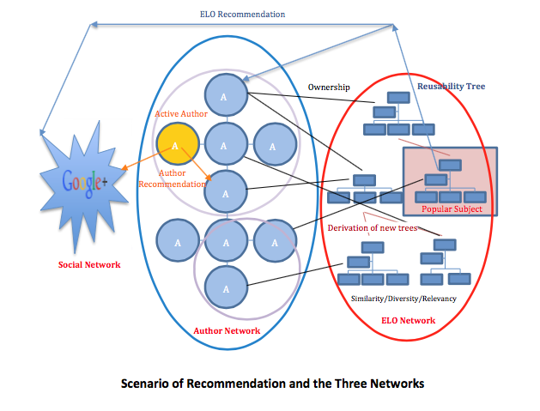
The Big Picture

Slide 43
The ELO Network
ELOs in a RT are related
Maintain the connection among ELOs between 2 RTs
Ownership of each ELO is maintained (to author network)
A user can only see ELOs owned by himself/herself, and those published
Goal: Popular ELOs are recommended
Reusability Trees
Ownerships
Connection of Trees
Popular Subject
ELO Recommendation
Similarity
Diversity
Relevancy
ELO Network

Slide 44
The Author Network
An Author Group is created by an initiator
One or more Author Groups exist in the Author Network
Authors in the same group share common background or common interests
Join by invitation and a confirmation
Goal: Expert authors can be recommended
Author Recommendation
A3
A1
A4
A5
A2
Ownerships
Active Author
A7
A5
A8
A9
A6
Author Network
(with multiple Author Groups)

Slide 45
Information of an Author
Basic Information
Name, email, etc.
Pedagogical Information (to define similarity)
Teaching Category: e.g., high school
Teaching Subject Area: e.g. physics
Others
Social Information
Preference Author Groups: created or joined via invitation
Preference Co-Workers: authors sharing ELOs can be in a group
Friends in Social Networks (in Google+)

Slide 46
Forming Author Groups
A new Author Group can be created
When a new author uses an ELO shared from the original author, the new author is invited to join the same Author Group with the original author, i.e., Preference Co-Workers
The system can recommend a new author to join by checking user similarity based on
Teaching Category
Teaching Subject Area
Similarity between two vocabularies are defined

Slide 47

The Social Network
How to increase the number of authors in the Author Network?
Need help from friends of existing authors
Using Google+ as an extension, to recommend friends of authors to join
The system can recommend ELOs or authors to friends in Social Network
ELO Recommendation
Author Recommendation
Social Network

Slide 48
Goals
Goals: suggests active authors and popular subjects
Practical solutions that are implemented easily
Need two functions
Degree_of_Participation(User): how active, a real number
Areas_of_Expertise(User): what he/she knows, a list of keywords
Expected Computation Results
A list of Active Authors
e.g., A5: 8.75 A1: 7.0 A7: 6.0 A8: 6.0 A9: 6.0 A4: 5.5 A3: 5.0 A2: 4.0 A6: 3.0
A list of Popular Subjects (i.e., keywords)
e.g., high school:1 general:2 undergraduate:3
e.g., Physical Education:2 Basketball:2 Java:3 Linked List:1

Slide 49
Computing Functions
Degree of Active Participation: how active the user accesses the Author Network
e.g., Degree_of_Participation(User) = 7.0
Areas of Expertise: a list of keywords (with frequency counts)
e.g., Areas_of_Expertise(User) = [high school:1, general:1, Physical Education:3, Basketball:5]
Need to use a set of properties from ELO, Author, and Group

Slide 50
ELO Properties
The number or ELOs the author created: ELO_{c}(User)
The number of ELOs the author revised: ELO_{r}(User)
The number of ELOs the author published (including created and revised ELOs): ELO_{p}(User)
Is ELO_{c}(User) + ELO_{r}(User) equals to ELO_{p}(User)? No
Could exist some ELOs not published
The number of other ELOs directly revised from the author’s published ELOs: ELO_{u}(User)
Similar to citation counts

Slide 51
ELO Influence
ELO_Influence(User) =
ELO_Creation_Influence(User) * c-weight +
ELO_Publishing_Influence (User) * p-weight
ELO_Creation_Influence(User) = ELOc(User) + ELOr(User) * β₁
or
ELO_Creation_Influence(User) =
ELOc(User) +Σ( E  ELOr(User)  Diversity(E, parent(E))
β₁ = (0.9)^{d} , where integer d > 0 is the distance from a ELO to its root ELO in a reusability tree (i.e., decreases the impact)
Or, use Diversity() to compute how much additional information the user created

Slide 52
ELO Influence (cont.)
ELO_Publishing_Influence (User) =
ELOp(User) + ELOu(User)
Counts how many ELOs are published and how many are cited
Everything counts
c-weight + p-weight = 1.0

Slide 53
Group and Author Properties
The number of Author Groups created by the author: Group_{c} (User)
The number of Author Groups joined (i.e., the “follow” relationship) by the author: Group_{j}(User)
How many other authors joined the Author Groups created by the author (i.e., the “followed by” relationship): Author_{j}(User)
How many users/authors from a Social Network (Google+) who are the friends of the author, and are invited and joined the Author Network through recommendation: Author_{s} (User)

Slide 54
Author-Group Influence
Author_Group_Influence(User) =
(Group_{c} (User) * β₂ + Group_{j}(User) * β₃ ) * g-weight +
(Author_{j}(User) + Author_{s} (User)) * a-weight
β₂ +β₃ =1.0, represent weights
g-weight + a-weight = 1.0

Slide 55
Degree of Participation
Degree_of_Participation(User) =
g(ELO_Influence(User) +
Author_Group_Influence(User))
Function g() further takes the two functions and justify the importance of ELO and Author influences.
Or, another similar function
A list of Active Authors: the algorithm can search on Degree_of_Participation(User) from all authors, list top authors and the Author Group they belong

Slide 56
Areas of Expertise
The current approach uses Keywords
Teaching Category (with fixed vocabulary)
Teaching Subject Area (with fixed vocabulary)
Keywords from all ELO created by the author
Name and Description of Author Group (use keyword extraction)
[a list of keywords] = Areas_of_Expertise(User)
A list of Popular Subjects: the algorithm can compute Areas_of_Expertise(User) from all authors, and compute the intersection of lists of Keywords from all authors, list top intersected keywords and the corresponding authors.

Slide 57
Recommending Leading Authors and Popular ELOs
Needs to know who to recommend
So far, we only recommend ELO or authors to others in the same author group or friends in social network.
Additional recommendation algorithms can be used
Recommendation in Author Group
Recommendation in Social Network
Author Recommendation
ELO Recommendation

Slide 58
The Proposed Algorithms (1)
Algorithm: Author_Recommendation_to_the_Same_Author_Group
Input: an author called User
Output: Recommend User to other authors in User’s Author Group(s)
if Degree_of_Participation(User) > α
∀ Author ∈ AuthorGroup(User)  Recommend(User, Author)
This algorithm recommends top active authors to other authors in the same Author Group
α is a threshold set by system for recommendation
Recommend(User, Author) recommends User to Author

Slide 59
The Proposed Algorithms (2)
Algorithm: Author_Recommendation_to_Social_Network
Input: an author called User
Output: Recommend User to other users in Social Network
if Degree_of_Participation(User) > α
∀ Author ∈ Social Network 
Friends(User, Author)  Recommend(User, Author)
The algorithm may recommend active User to those potential users in Social Network
Only friends of User are recommended
The system send a link via email to encourage the users in Social Network to join

Slide 60
The Proposed Algorithms (3)
Algorithm: ELO_Recommendation_to_the_Same_Author_Group
Input: an author called User
Output: Recommend ELOs to other authors in User’s Author Group(s)
if Degree_of_Participation(User) > α
Let Keyword_List = Areas_of_Expertise(User)
Let ELO_List = Metadata_Search(Keyword_List)
∀ ELO ∈ ELO_List  ∀ Author ∈ Author_Group(User) 
Send_ELO(ELO, Author)
The algorithm finds area of expertise of active participator User
uses a Metadata_Search() function to find a list of ELOs that match the keyword list of User
calls the Send_ELO() function to recommend ELO to authors in the same Author Group with User, by using Author_Group(User)

Slide 61
The Proposed Algorithms (4)
Algorithm: ELO_Recommendation_to_Social_Network
Input: an author called User
Output: Recommend ELOs to friends of User in Social Network
Let Keyword_List = Areas_of_Expertise(User)
Let ELO_List = Metadata_Search(Keyword_List)
∀ Author ∈ Social Network  ∀ ELO ∈ ELO_List 
Friends(User, Author)  Send_ELO(ELO, Author)
The algorithm may recommend ELOs to those potential users in Social Network

Slide 62
Project Website
http://edxpdrlab.ncu.cc
Project Information
Project Scope
Source Code and Tool for Download
Technical report, final report
Source Code
Tools
ELO Editor, Window and iOS
Server side program
User’s Manual, Publications
Video Demonstrations, Presentations

Slide 63
Video Demonstrations
The ELO Editor
ELO Editor Video Demonstration.mp4
The Common Repository
CommonRepo Introduction.mp4
See Project Website
http://edxpdrlab.ncu.cc

Slide 64


We Are Looking for Partners
Sharing Tools
Sharing Source Code
Joint Publication
You need to
Use the tool
Give us feedbacks
Line “Learning Object Center Group”
WeChat “Learning Object Center Group”
For Research only
Project Website: http://edxpdrlab.ncu.cc

Slide 65


Summary
E-Learning and MOOCs
Searching via IEEE LOM
The Repository – Common Repo
Author Network among ELO Users
Social Network based on Google+
Hope to work with you
Data Mining, Semantics, Social Media, Recommender, Contents
Research Group

